Slide 1


Romanian NMA Training Placement Scheme 2024-2026
Claudiu Adam, Eugen Mihuleț
Bucharest, Nov 15th 2024

Slide 2
Content of the presentation
Objectives of the program
Assumptions
Technical basis
Scientific basis
Existing solutions
Development approach
Risks and risk mitigation
References
Bucharest, Nov 15th 2024

Slide 3
Objectives of the placement scheme
Primary objective:
adopt and integrate an established ML-based nowcasting system (i.e. COALITION-4) that aligns with the NMA's operational requirements for severe weather warnings, ensuring high precision in the 0–1 hour lead times for heavy rain, hail, and lightning
integrate data sources, including radar, MTG satellite imagery, lightning detection sensors, and NWP models
thoroughly document the adaptation process of the solution, enabling its use by other EUMETSAT member states
Bucharest, Nov 15th 2024

Slide 4
Objectives of the placement scheme
Secondary objectives:
explore ML-based solutions that extend predictive capabilities beyond the immediate nowcasting window, up to 6 hours (building upon existing solutions like ConvSNow or DeepSat ML models developed within NMA)
Support NWCSAF consortium activities
explore the possibility of generating up to 1 hour predictions on LI activity using MTG LI data and a ML approach
investigate the use of MTG LI products as an alternative to ground-based lightning detection systems in the integrated nowcasting tool
Bucharest, Nov 15th 2024

Slide 5
Assumptions
It would be preferable to adapt an existing solution, rather than developing a new one
ML models relying primarily on radar data are inherently constrained in their ability to provide accurate predictions beyond a 1-hour lead time
Datasets are well structured and formatted, i.e. pre-processed for the training, testing, and validation phases
Established testing pipeline, resembling real world scenarios, for all iterations of the ML model
The architecture of the proposed solution will still be relevant in the near-future (next 2-3 years?) and could be employed by other EUMETSAT members
Adequate expertise in ML and computer science, i.e. early-stage researcher with ML background, leading technical efforts, with full-support from experts from different departments (forecasting, satellite, radar, NWP)
Adequate hardware infrastructure (up to 6 server-grade workstations with NVIDIA RTX A6000 GPUs - 48GB of VRAM or EWC)
Bucharest, Nov 15th 2024

Slide 6
Technical basis – data
Satellite data - MSG and MTG satellite imagery and RGB products
Radar data - high-resolution data from the new and old national radar systems (Leonardo, 7 locations)
Lightning data - LINET lightning data from the national system (8 stations)
NWP data (ICON 2.8, COSMO 7 and 2.8, ALARO 6.5 and 4, ECMWF Hres)
ERA5 reanalysis data (for initial training of the ML model)
AWS (surface and upper-air measurements for validation)
Bucharest, Nov 15th 2024

Slide 7
Scientific basis – tools
Development tools and platforms considered:
Python as the main programming language due to its versatility in the ML/AI field
Docker on a Linux distribution, i.e Ubuntu, for virtualization (standardized training procedure in TensorFlow/PyTorch)
AWS/GCP/Azure for testing and deploying the ML model into a cloud environment
Pytroll, pySTEPS for data processing and visualization
TensorFlow/PyTorch for training the ML solution
ADAGUC Server for data distribution and visualization
IBL's Visual Weather for forecaster interface
In case it’s necessary, EWC for scalable computing resources
Bucharest, Nov 15th 2024

Slide 8
Scientific basis – blending techniques
Key considerations:
Scalability ensures the system can handle increasing data volumes.
Interoperability ensures compatibility with existing weather systems and data formats.
Latency optimization for near-real-time performance.
Fault-tolerant systems for continuous operation.
Model containerization:
Package the model in containers (Docker) for scalable deployment that can easily be integrated with orchestration systems (Kubernetes).
Model monitoring:
Use monitoring tools (Weights & Biases) to track model performance and use feedback from operational predictions to continuously fine-tune the model.
Bucharest, Nov 15th 2024

Slide 9
Scientific basis – relevant ML/AI solutions (ML approach)
COALITION-4 (baseline and development starting point) – Operational short-range model at MeteoSwiss (Switzerland), Github codebase available, convolution-recurrent neural network approach used for predicting short lead-time weather events (lightning, hail, and heavy precipitation), trained on radar observations, satellite imagery, lightning measurements, NWP forecasts, and DEM data (considered)
AtmoRep – Global medium-range model, open source codebase, task-independent transformer-based neural network used for nowcasting, temporal interpolation, downscaling, and data bias correction, trained on ERA5 reanalysis data (considered)
FengWu – Global medium-range multi-modal model, ONNX model available, encoder-decoders and cross-modal fusion Transformer along with a replay buffer mechanism to improve forecast performance (from RL literature), trained on ERA5 data (partially considered – architecture)
Bucharest, Nov 15th 2024

Slide 10
Scientific basis – relevant ML/AI solutions (physics + ML approach)
DeepPhysiNet – Deep neural network that combines a Transformer-based network for extracting spatiotemporal features and a physics network that acts as a solver for partial differential equations (PDEs) of near-surface meteorological variables through the loss function, Github codebase available, trained on ERA5 data on a 6h temporal resolution and used over regional areas of China for wind speed, temperature, and relative humidity forecasts (considered)
ClimODE – Neural advection PDE weather model, 3 components for capturing insights from data – attention conv network for global information, conv network for local information, and emission network for uncertainty estimation for lead times ranging from 6h to 36h, Github codebase available, trained on preprocessed version of ERA5 from WeatherBench (ground temperature, atmospheric temperature, geopotential, and ground wind vector of 6-hour timesteps) on a single 32GB NVIDIA V100 GPU (considered)
Bucharest, Nov 15th 2024

Slide 11
Existing solutions
Potential solutions to adapt or to take valuable insights from
ML solutions
Hybrid (physics + ML) solutions
From EUMETSAT (Integrated Nowcasting Tools – 23-25 January 2024)
Baseline models
EF Sat2Rad
COALITION-4
SepConv
ClimODE
DeepPhysiNet
AtmoRep
FengWu
NeuralGCM
AURORA
Prithvi WxC
Bucharest, Nov 15th 2024

Slide 12
Development approach (1) – Constraints and methodology
Key constraints:
Computational resources limited to RTX A6000 workstations.
Timeframe of 2 years for model development.
Methodology:
Fine-tuning existing solutions to leverage pre-trained models on, for example, ERA5 global data.
Apply knowledge distillation to simplify models by reducing complexity and computational demand.
Bucharest, Nov 15th 2024

Slide 13
Development approach (2) – ML pipeline
Three-component model structure:
Normal Weather (NW) model (trained on global ERA5 lower-resolution data - foundation model):
Optimal integration of spatial and temporal data (temporal-only if too much demand on hardware components).
Fine-tune on higher resolution localized data from RNMA.
2. Extreme Weather (EW) model:
Trained on extreme weather events, acts as a scoring/filtering system for probabilistic results from the NW model, generating an aggravation coefficient that will be used for the loss function of the physics model.
3. Physics-based (Physx) model:
Uses a neural network that models and applies physics constraints, through the loss function, on the original inputs and outputs from NW and EW models so that we can achieve more robust predictions.
Bucharest, Nov 15th 2024

Slide 14
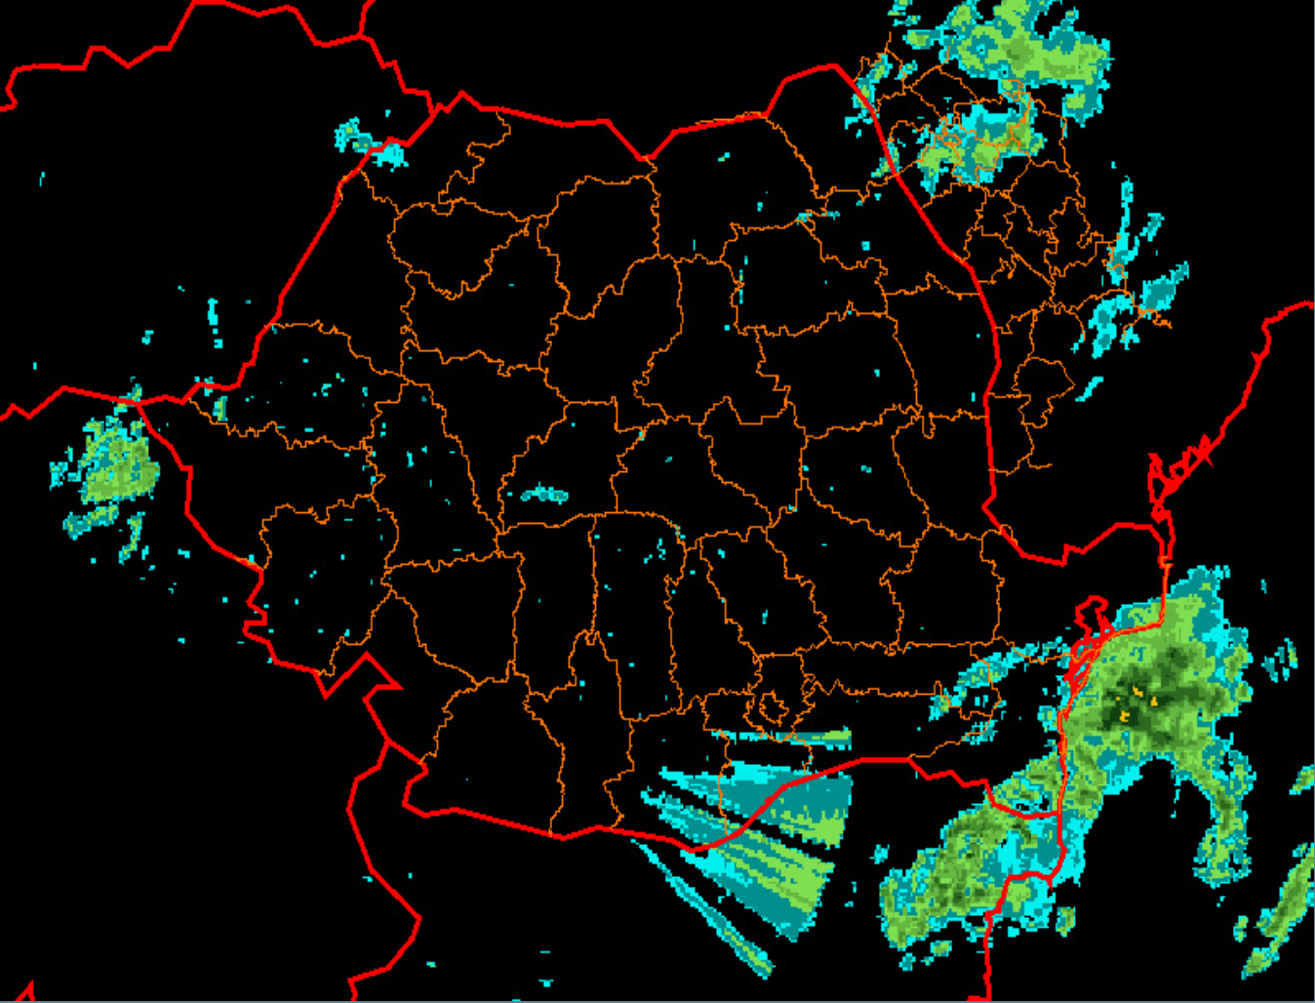



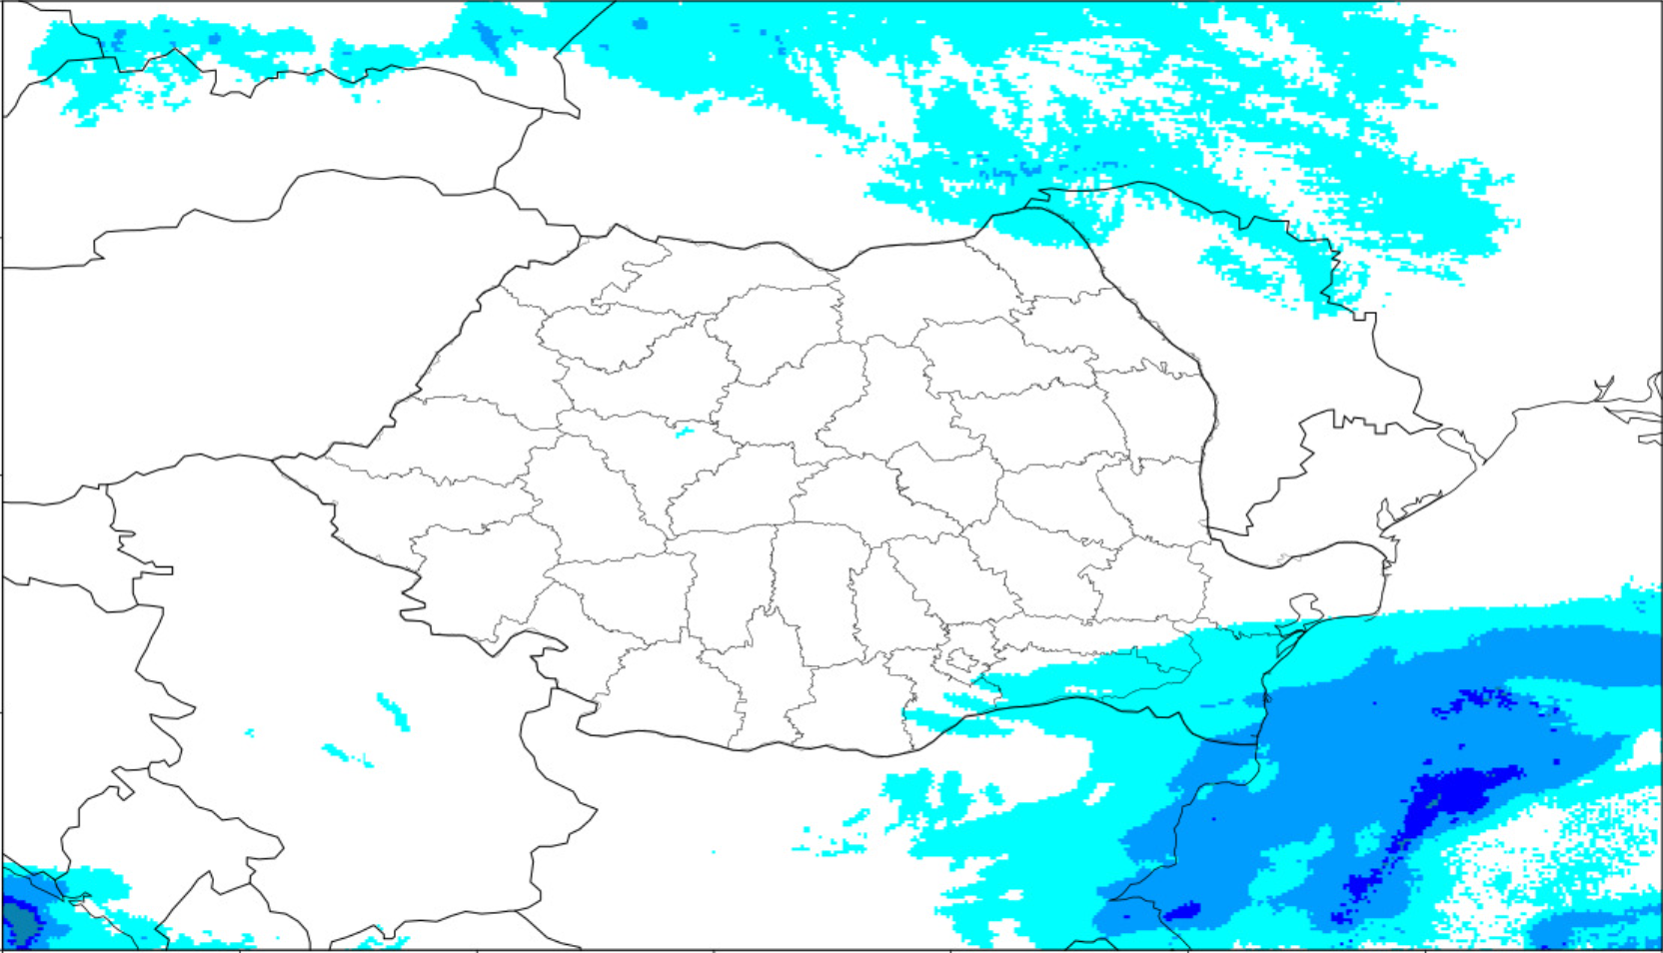
Development approach (3) – General pipeline scheme
Normal Weather network
Extreme Weather network
Physics-based network
Bucharest, Nov 15th 2024

Slide 15
Generic specific elements
Ensure the development of an adaptable data integration and preprocessing workflow to accommodate different formats and data sources
Ensure that the system can scale to handle various data volumes
Using OPERA data and working on the EWC
Ensure comprehensive documentation to facilitate adaptation by other organizations, mainly EUMETSAT member states
Working on the COALITION-4 git repository
Evaluate the performance of the model in the ESSL testbed
Explore the usage of LI data
Bucharest, Nov 15th 2024

Slide 16
National and NWCSAF specific elements
Romanian NMA severe weather warnings - 1 hour validity, at least 15 minutes lead time, specific thresholds for yellow, orange and red codes
Particular radar products and NWP output parameters
Assess the performance of the model when using LI data instead of ground network for lightning detection
Bucharest, Nov 15th 2024

Slide 17
Integration with the NMA operational environment
the model will generate NetCDF files to ensure seamless integration with the existing visualization tool, i.e. IBL's Visual Weather system
explore generating warning polygons in CAP or XML format to interface with the existing severe weather warning system, leveraging the experience from the EEA Norway grants project
design the workflow to support manual interventions for forecasters
Bucharest, Nov 15th 2024

Slide 18
Risks and risk mitigation
Reduced accuracy for lead times up to 1 hour
solution - engagement with the original developers for support during the adaptation process
Lower performance of the adapted model in the Romanian context
solution - adjustments to the model and the training data in order to accommodate the geography specific aspects
Delays in achieving program goals within the two years planned period
solution - regular progress monitoring and reporting to colleagues from EUMETSAT, including detailed six-month progress reports / prioritization of objectives, focusing on the primary goal /
alignment of secondary objectives with the primary one
Bucharest, Nov 15th 2024

Slide 19
References
ERA5
Hersbach, H., Bell, B., Berrisford, P., Hirahara, S., Horányi, A., Muñoz-Sabater, J., Nicolas, J., Peubey, C., Radu, R., Schepers, D., Simmons, A., Soci, C., Abdalla, S., Abellan, X., Balsamo, G., Bechtold, P., Biavati, G., Bidlot, J., Bonavita, M., … Thépaut, J.-N. (2020). The ERA5 global reanalysis. Quarterly Journal of the Royal Meteorological Society, 146(730), 1999–2049. https://doi.org/https://doi.org/10.1002/qj.3803
EF Sat2Rad
Küçük, Ç., Giannakos, A., Schneider, S., & Jann, A. (2023). Transformer-based nowcasting of radar composites from satellite images for severe weather. http://arxiv.org/abs/2310.19515
COALITION-4
Leinonen, J., Hamann, U., Sideris, I. v., & Germann, U. (2022). Thunderstorm nowcasting with deep learning: a multi-hazard data fusion model. https://doi.org/10.1029/2022GL101626
SepConv
http://www.cs.ubbcluj.ro/weadl/wp-content/uploads/2024/06/Predicting%20weather%20radar%20data%20using%20an%20ensemble%20of%20neural%20network%20models_Mihai.pdf
AtmoRep
Lessig, C., Luise, I., Gong, B., Langguth, M., Stadtler, S., & Schultz, M. (2023). AtmoRep: A stochastic model of atmosphere dynamics using large scale representation learning. http://arxiv.org/abs/2308.13280
FengWu
Chen, K., Han, T., Gong, J., Bai, L., Ling, F., Luo, J.-J., Chen, X., Ma, L., Zhang, T., Su, R., Ci, Y., Li, B., Yang, X., & Ouyang, W. (2023). FengWu: Pushing the Skillful Global Medium-range Weather Forecast beyond 10 Days Lead. http://arxiv.org/abs/2304.02948
NeuralGCM
Kochkov, D., Yuval, J., Langmore, I., Norgaard, P., Smith, J., Mooers, G., Klöwer, M., Lottes, J., Rasp, S., Düben, P., Hatfield, S., Battaglia, P., Sanchez-Gonzalez, A., Willson, M., Brenner, M. P., & Hoyer, S. (2023). Neural General Circulation Models for Weather and Climate. https://doi.org/10.1038/s41586-024-07744-y
AURORA
Bodnar, C., Bruinsma, W. P., Lucic, A., Stanley, M., Brandstetter, J., Garvan, P., Riechert, M., Weyn, J., Dong, H., Vaughan, A., Gupta, J. K., Tambiratnam, K., Archibald, A., Heider, E., Welling, M., Turner, R. E., & Perdikaris, P. (2024). Aurora: A Foundation Model of the Atmosphere. http://arxiv.org/abs/2405.13063
Prithvi WxC
Schmude, J., Roy, S., Trojak, W., Jakubik, J., Civitarese, D. S., Singh, S., Kuehnert, J., Ankur, K., Gupta, A., Phillips, C. E., Kienzler, R., Szwarcman, D., Gaur, V., Shinde, R., Lal, R., da Silva, A., Diaz, J. L. G., Jones, A., Pfreundschuh, S., … Ramachandran, R. (2024). Prithvi WxC: Foundation Model for Weather and Climate. http://arxiv.org/abs/2409.13598
ClimODE
Verma, Y., Heinonen, M., & Garg, V. (2024). ClimODE: Climate and Weather Forecasting with Physics-informed Neural ODEs. http://arxiv.org/abs/2404.10024
DeepPhysiNet
Li, W., Liu, Z., Chen, K., Chen, H., Liang, S., Zou, Z., & Shi, Z. (2024). DeepPhysiNet: Bridging Deep Learning and Atmospheric Physics for Accurate and Continuous Weather Modeling. http://arxiv.org/abs/2401.04125
Bucharest, Nov 15th 2024

